Slide 1
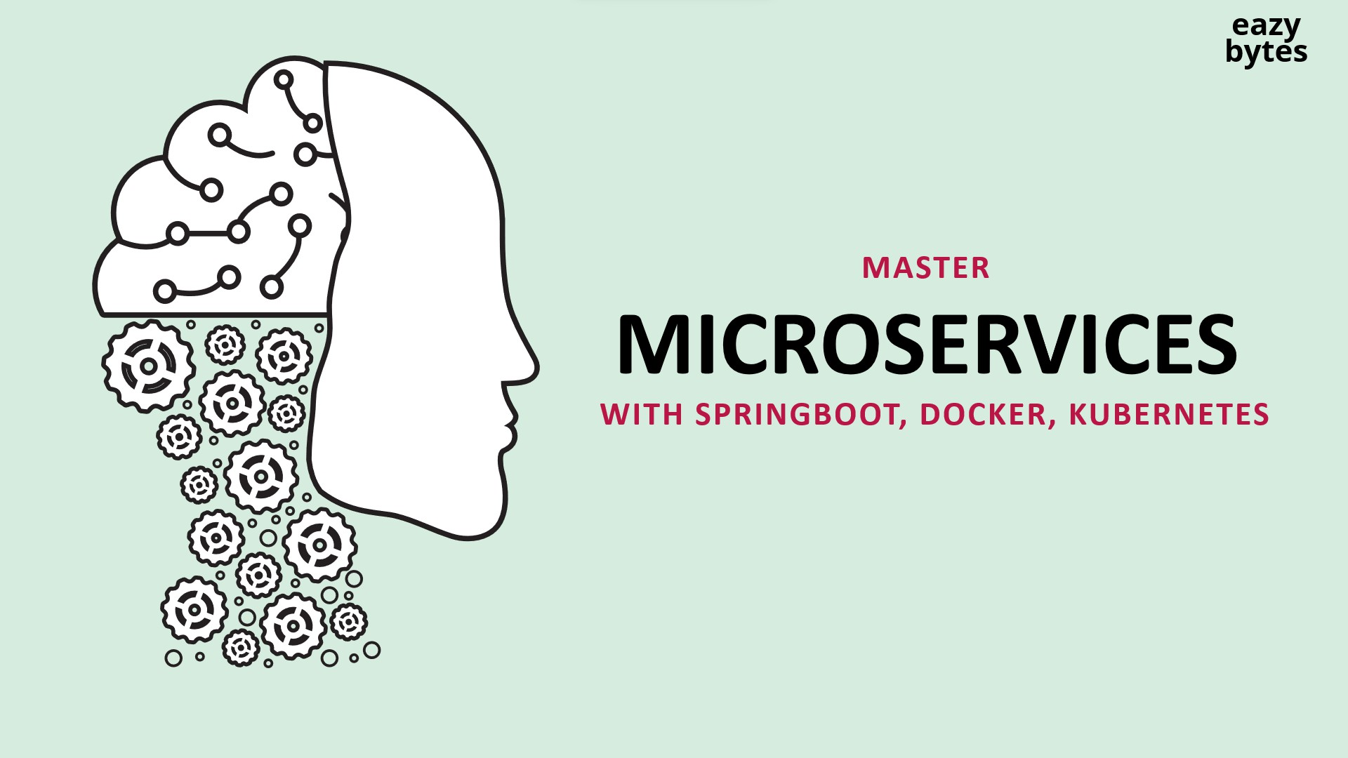
Microservices
With Spring Boot, Docker, Kubernetes

Slide 2

Agenda
Welcome to the world of microservices
Building microservices business logic using Spring Boot
How do we right size our microservices and identify boundaries
How to containerize our microservices using Docker
Configurations Management in microservices using Spring Cloud Config
Service Discovery & Service Registration in microservices using Eureka
Building and edge server for microservices using Spring Cloud Gateway

Slide 3
Agenda
Making microservices Resilient using Resiliency4J patterns
Implement Observability and monitoring of microservices using Grafana Prometheus etc.
Securing microservices using OAuth2/OpenID and Spring Security
Event Driven microservices using RabbitMQ, Spring Cloud Functions and Stream
Event Driven microservices using Kafka, Spring Cloud Functions and Stream
Container Orchestration using Kubernetes

Slide 4
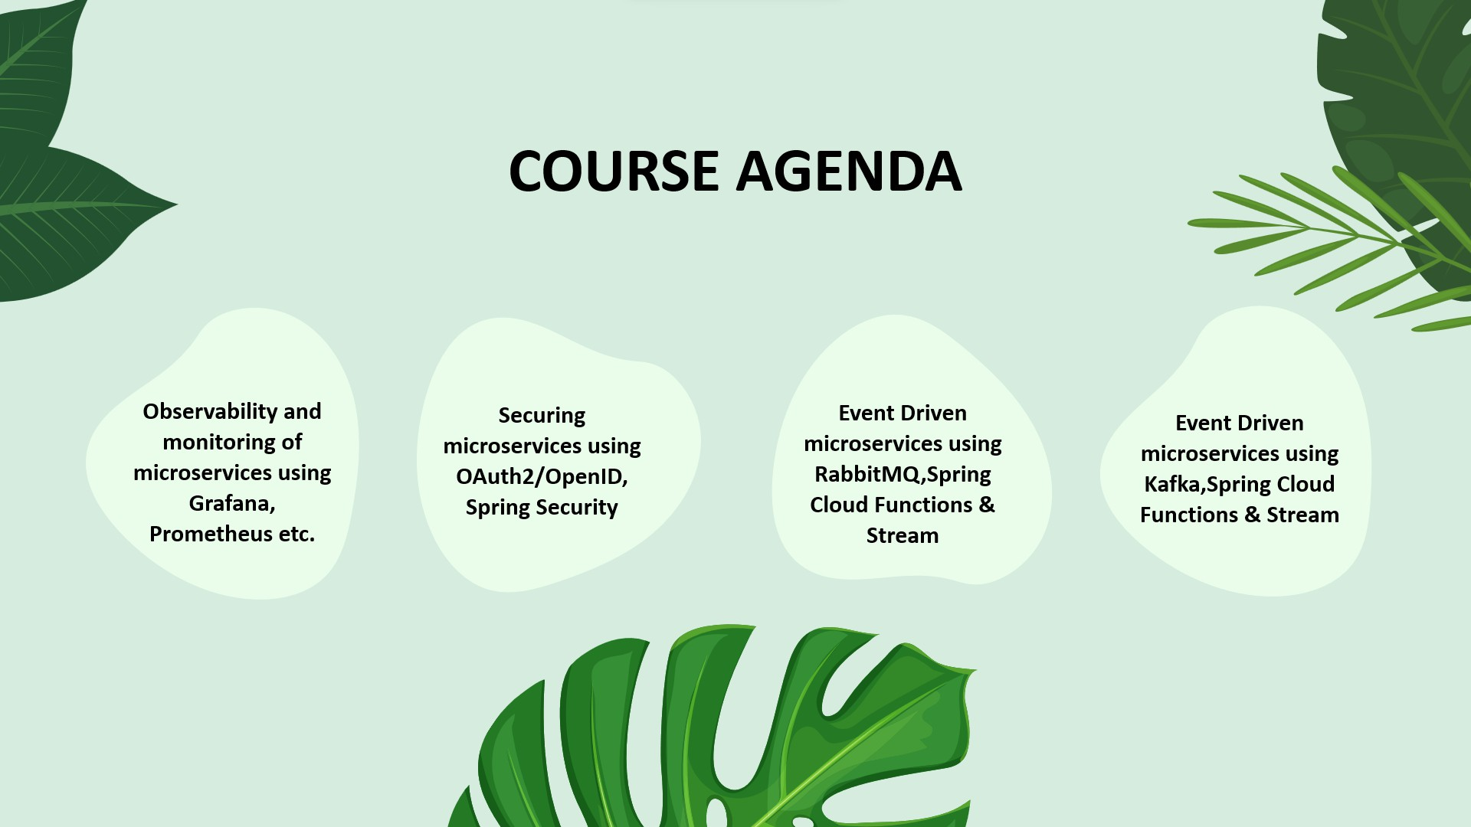
Agenda
Deep dive on Helm(Kubernetes package manager)
Deploying microservices into cloud Kubernetes cluster
Many best practices techniques followed by real time microservices developers

Slide 5
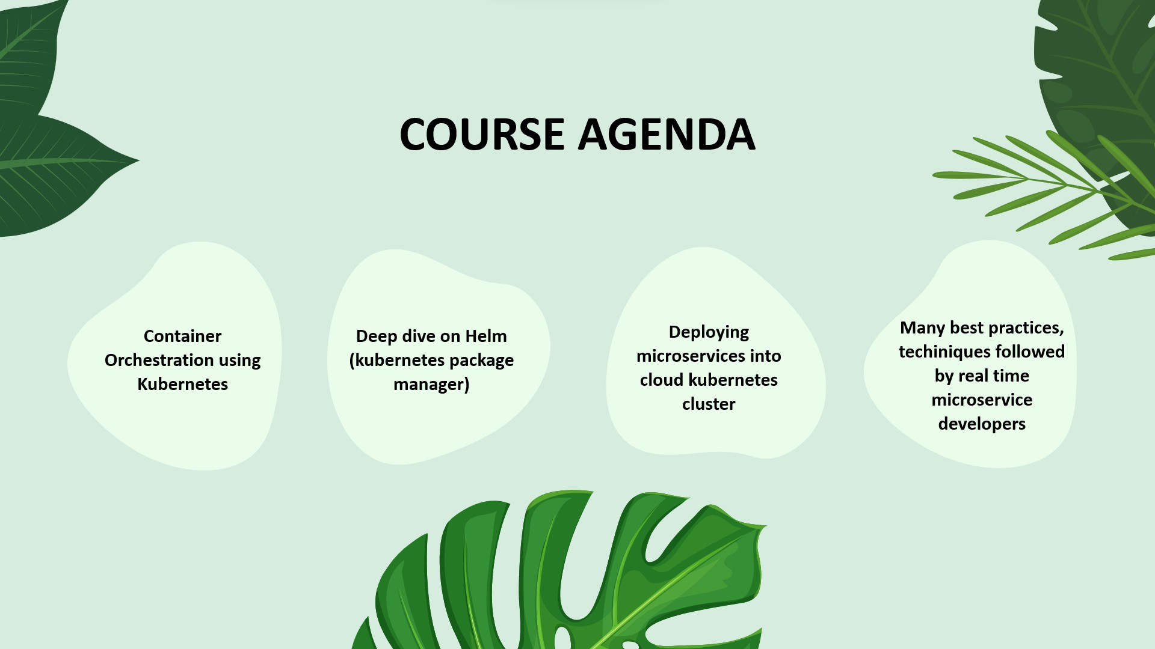
What are Microservices?
To understand microservices lets imagine a bank called EazyBank
Typically, banks comprise various departments, including
Accounts
Cards
Loans

Slide 6
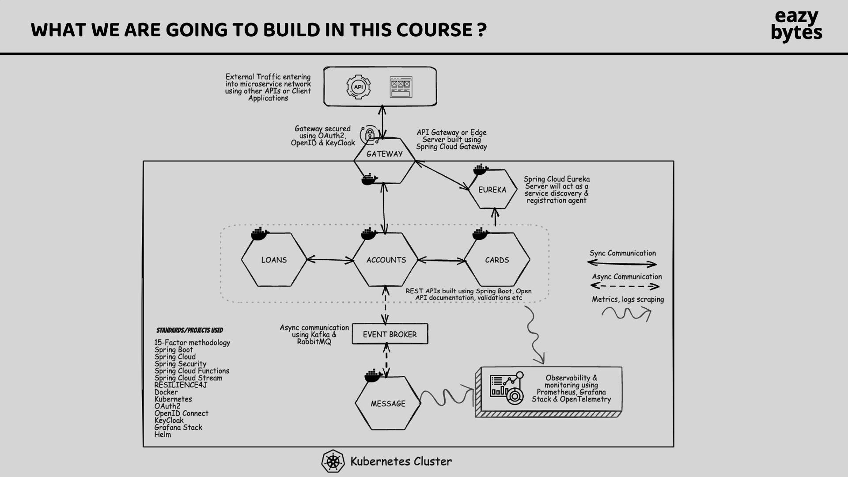
The Monolith
Back a decade, all the applications used to be deployed as a single unit where all functionality deployed together inside single server.
We call this architecture approach as Monolithic.
Pros
Simpler development and deployment for smaller teams and applications
Fewer cross-cutting concerns
Better performance due to no network latency

Slide 7
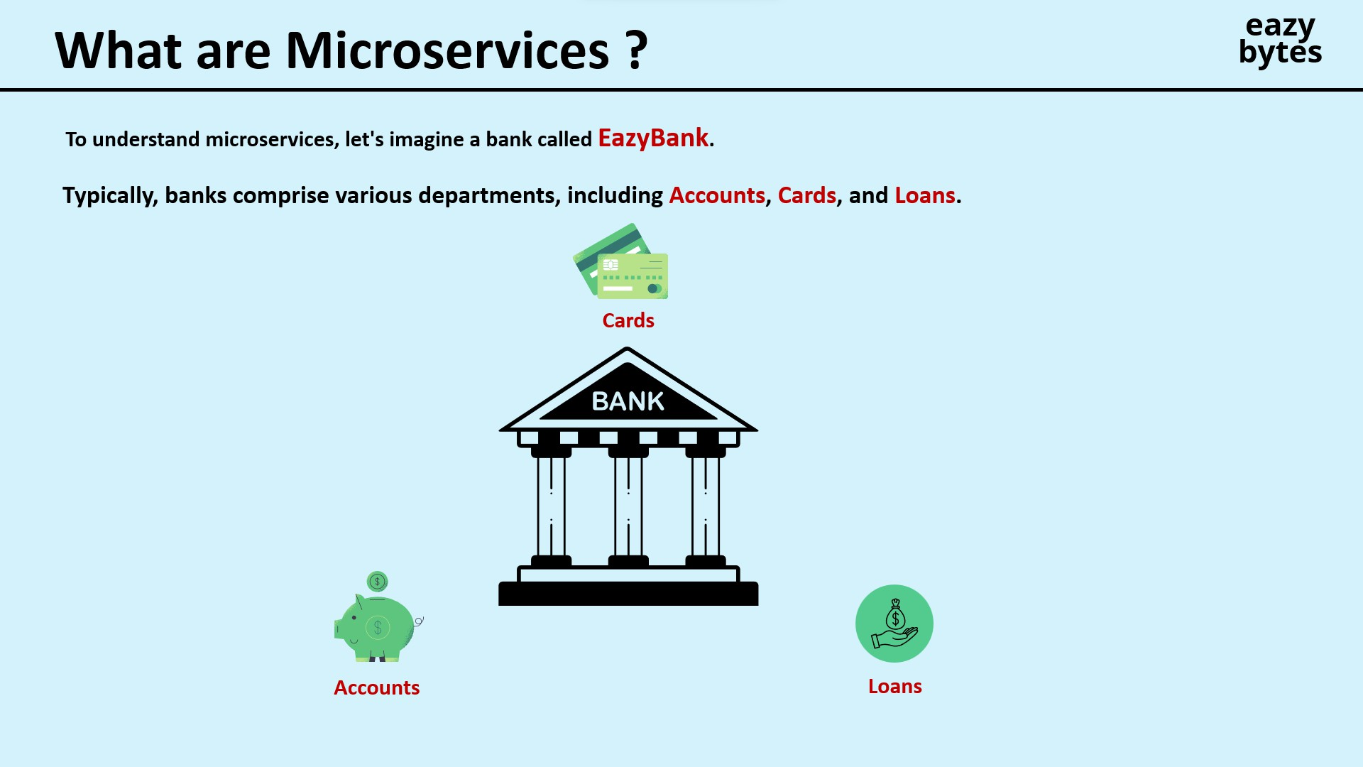
The Monolith
Cons
Difficult to adopt new technologies
Limited agility
Single code base and difficult to maintain
Not fault tolerance
Tiny update and feature development always need a full deployment

Slide 8
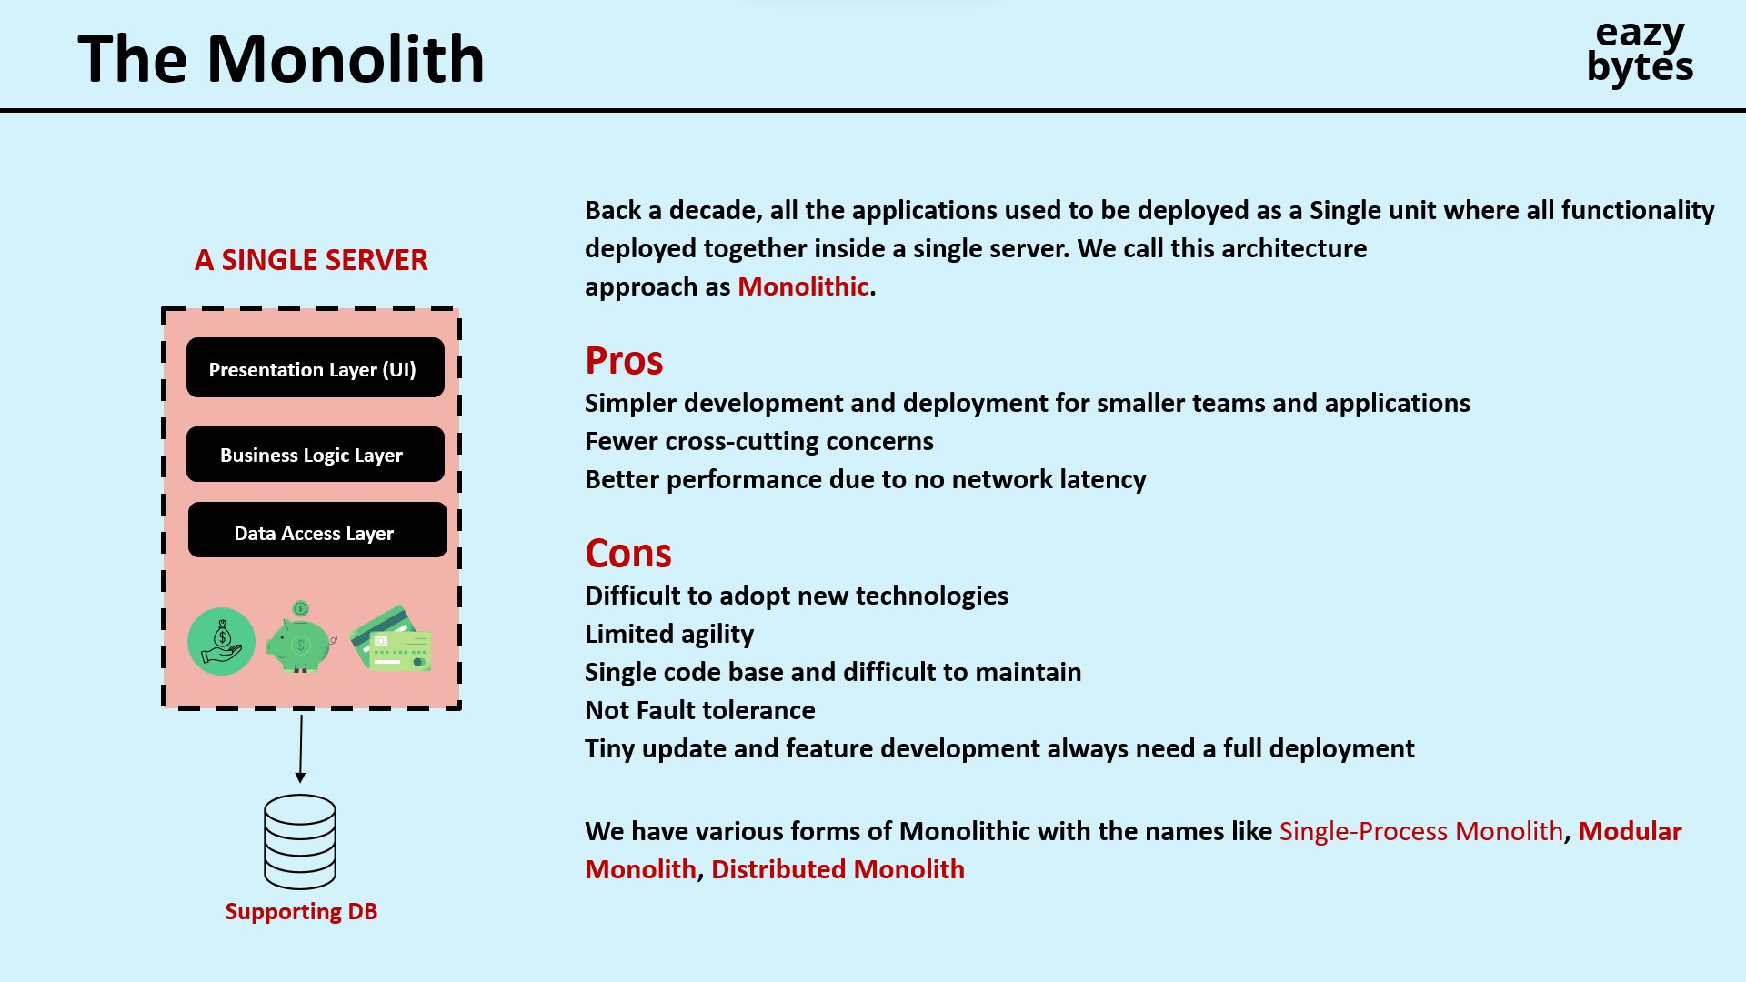
The SOA(Service-Oriented Architecture)
SOA emerged as an approach to combat the challenges of large, monolithic applications.
It is an architectural style that focuses on organizing software systems as a collection of loosely coupled, interoperable services.
It provides a way to design and develop large scale applications by decomposing them into smaller, modular services that can be independently developed, deployed and managed.

Slide 9
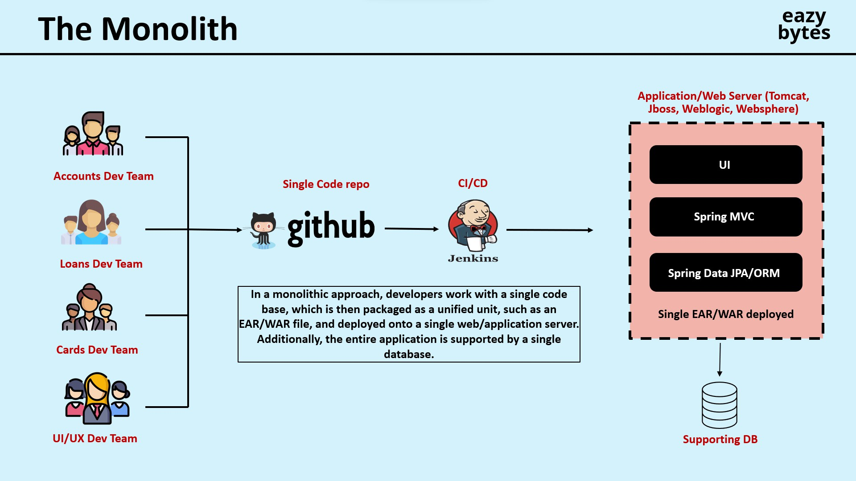
The SOA(Service-Oriented Architecture)
Pros
Reusability of services
Better maintainability
Higher reliability
Parallel development
Cons
Complex management due to communication protocols
High investment costs to vendor in middleware
Extra overload

Slide 10
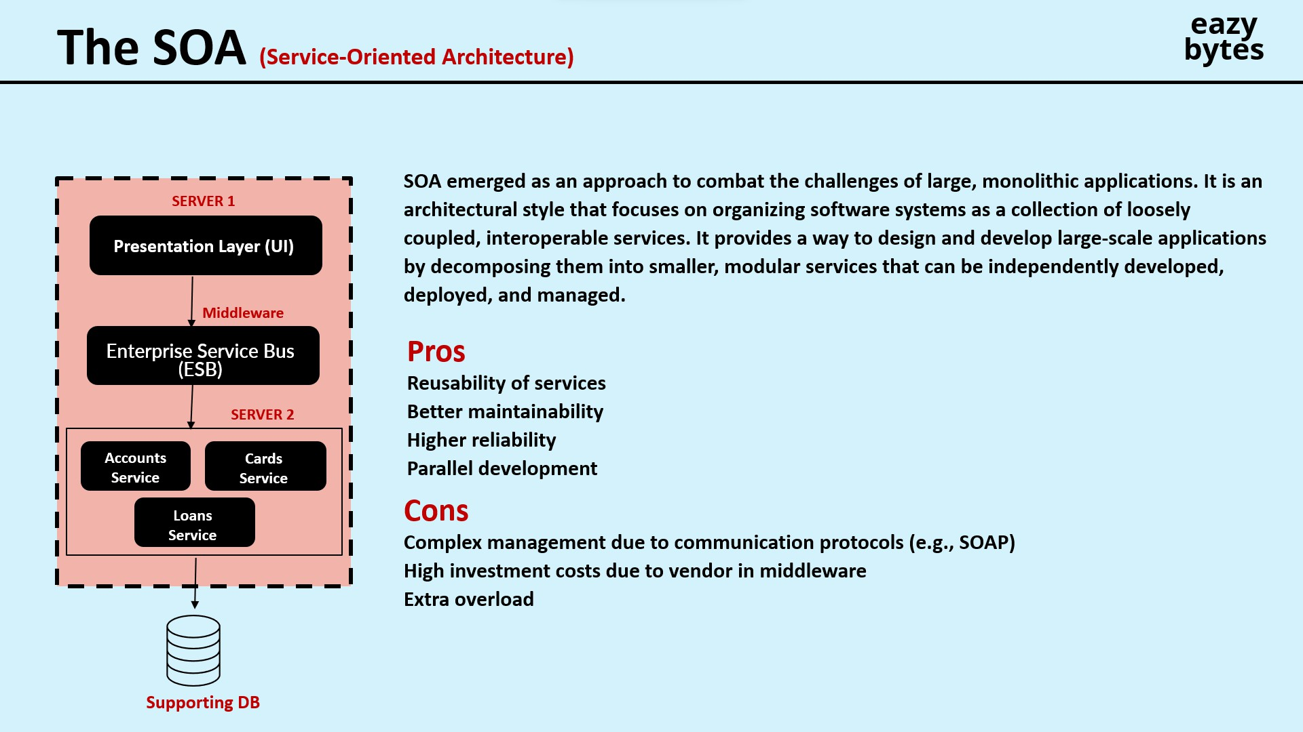
The Great Microservices
Microservices are independently releasable that are modelled around a business domain.
A service encapsulate functionality and make it accessible to other services via microservices might represent Accounts, another Cards, and yet another Loans, but together the might constitute an entire bank system.

Slide 11
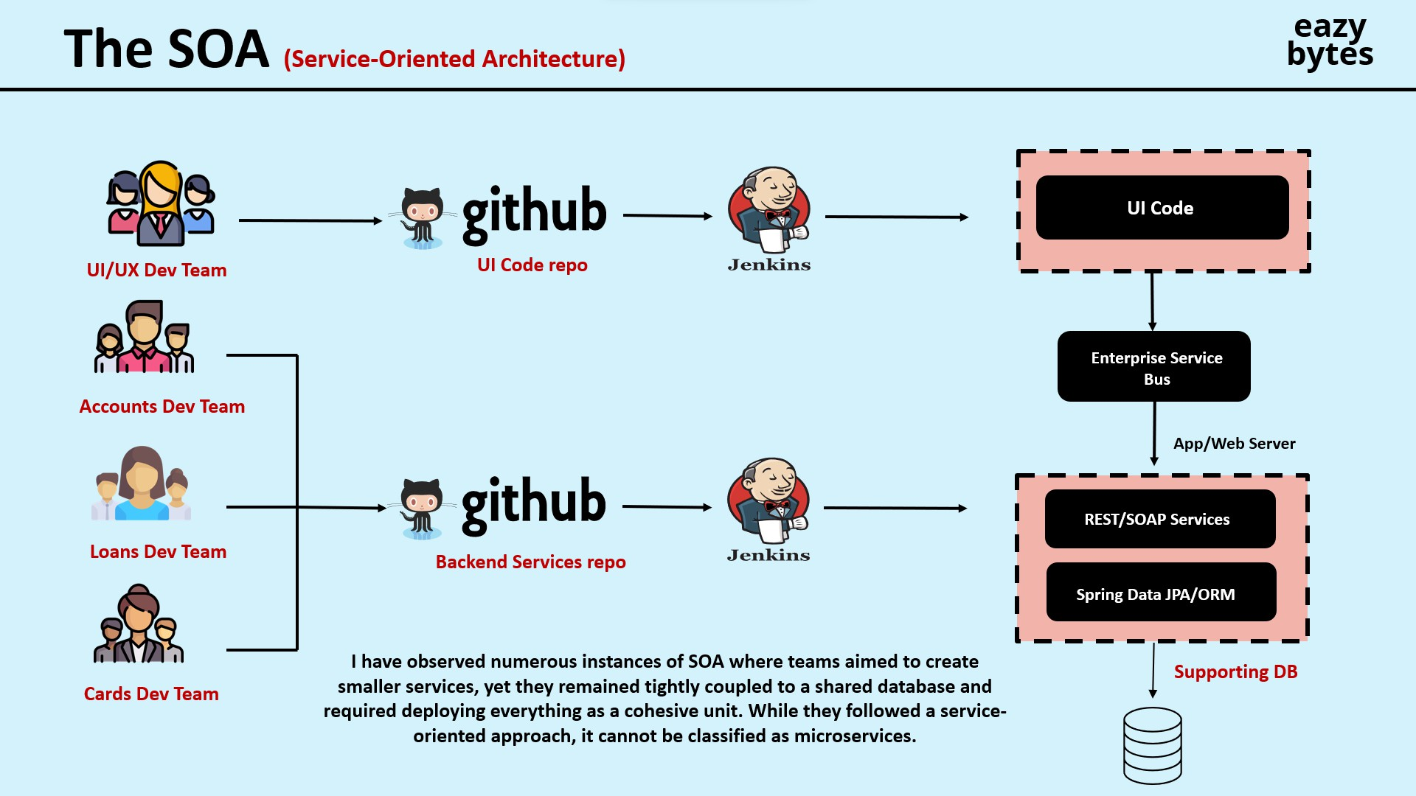
The Great Microservices
Pros
Easy to develop, test and deploy
Increased agility
Ability to scale
Parallel development
Modelled Around a Business Domain
Cons
Complexity
Infrastructure Overhead
Security Concerns

Slide 12
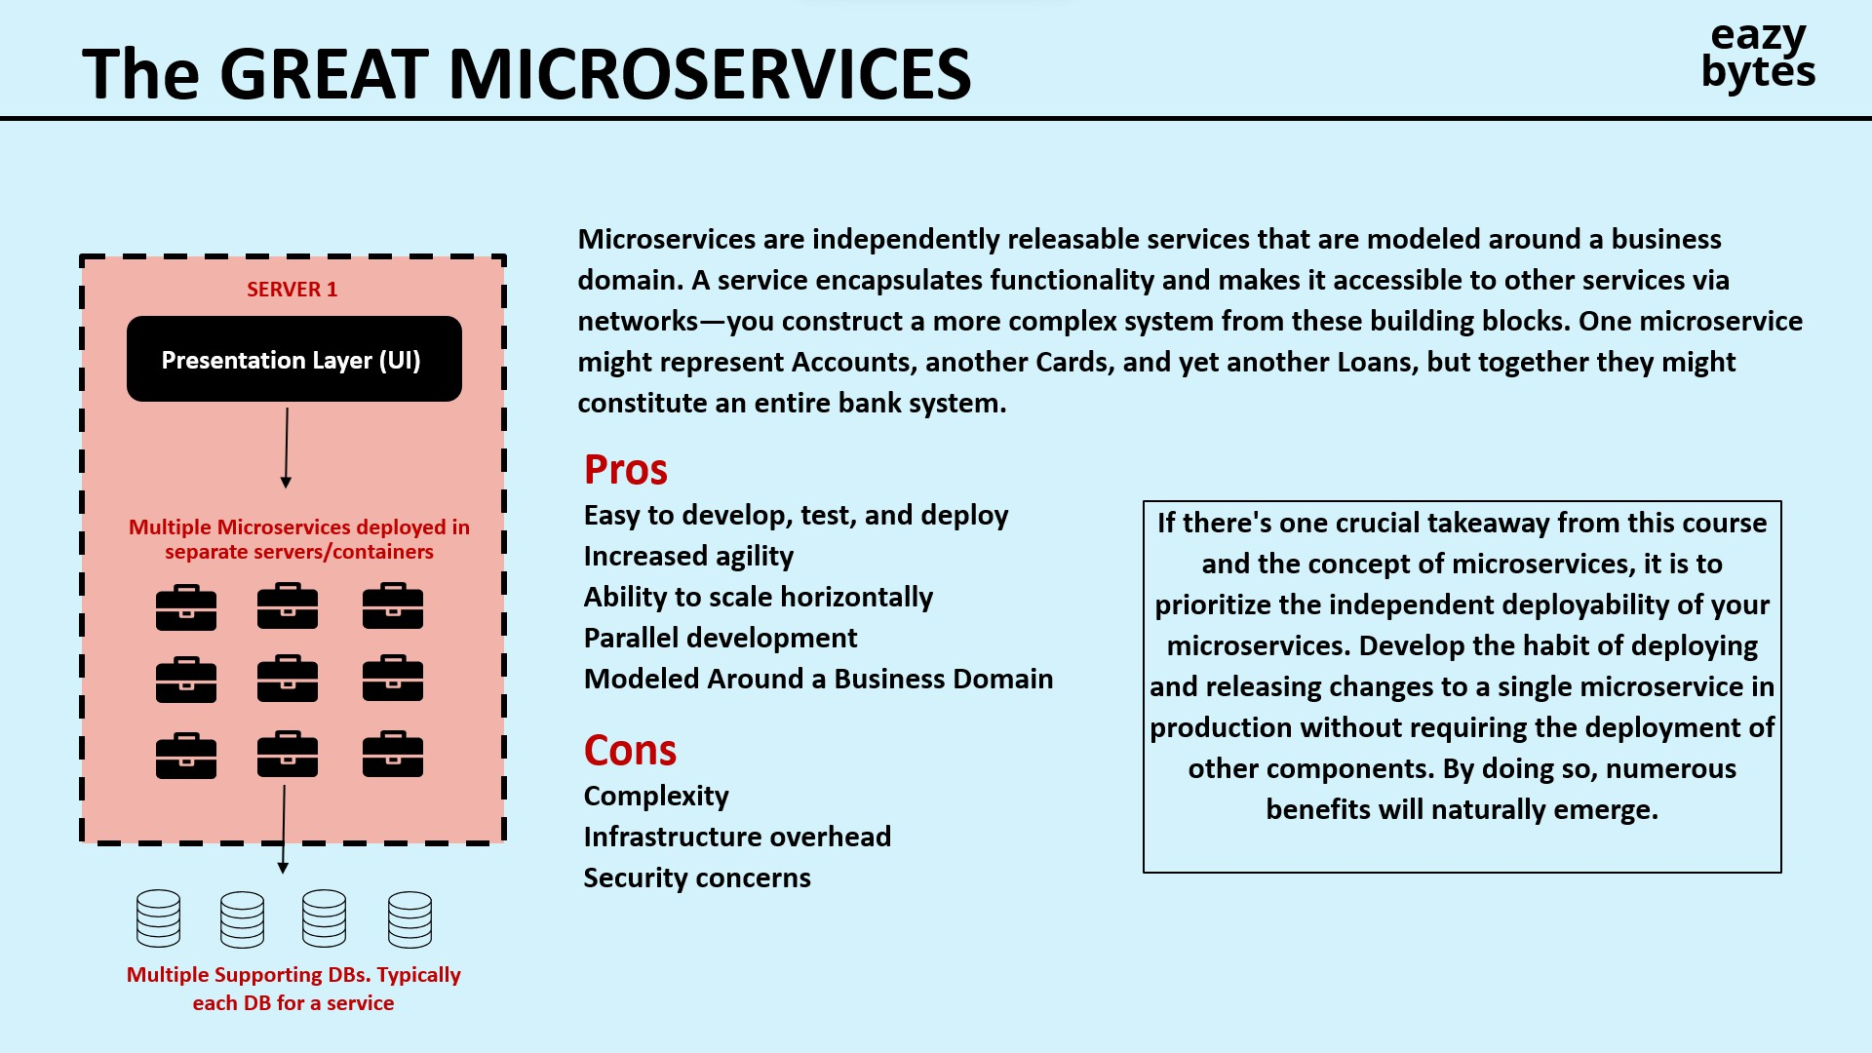

Slide 13
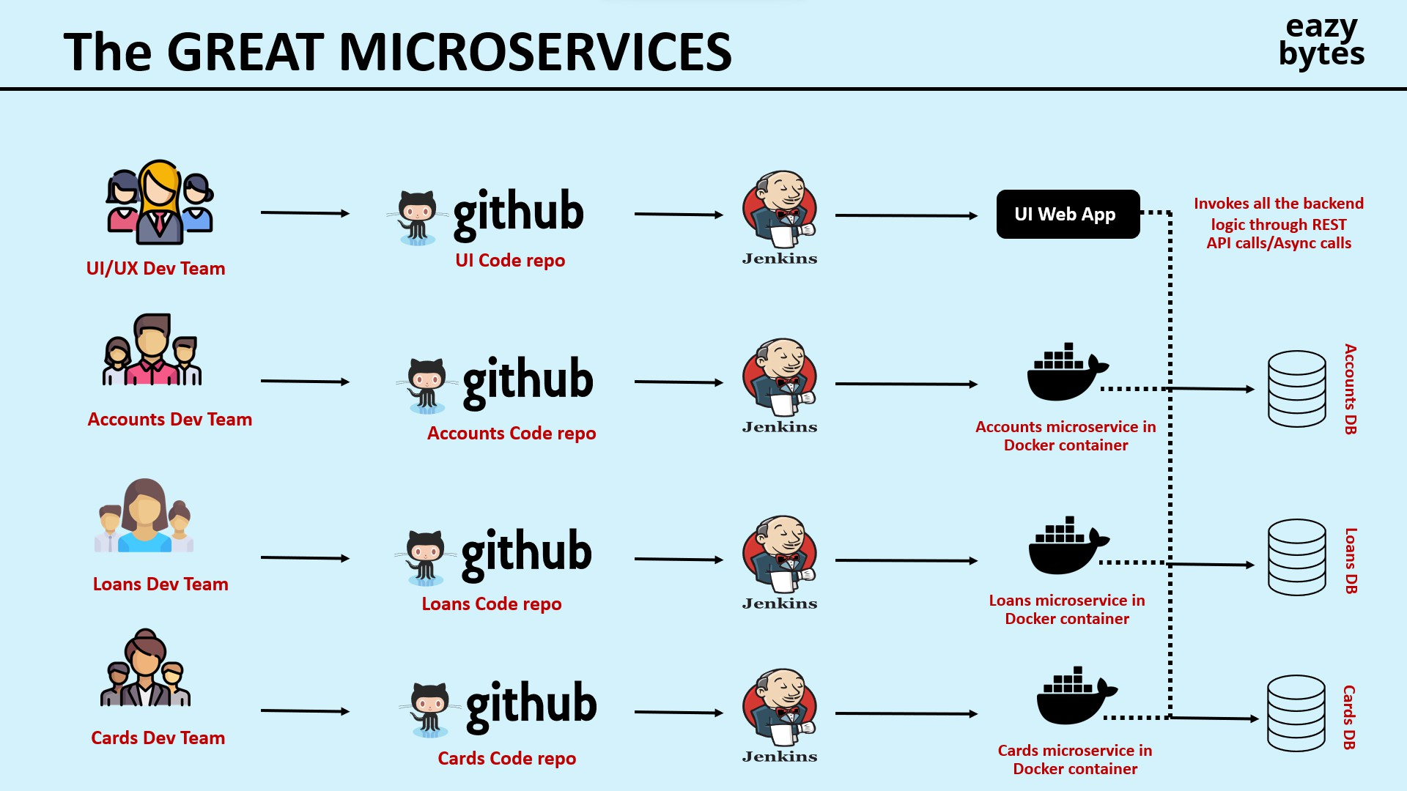

Slide 14
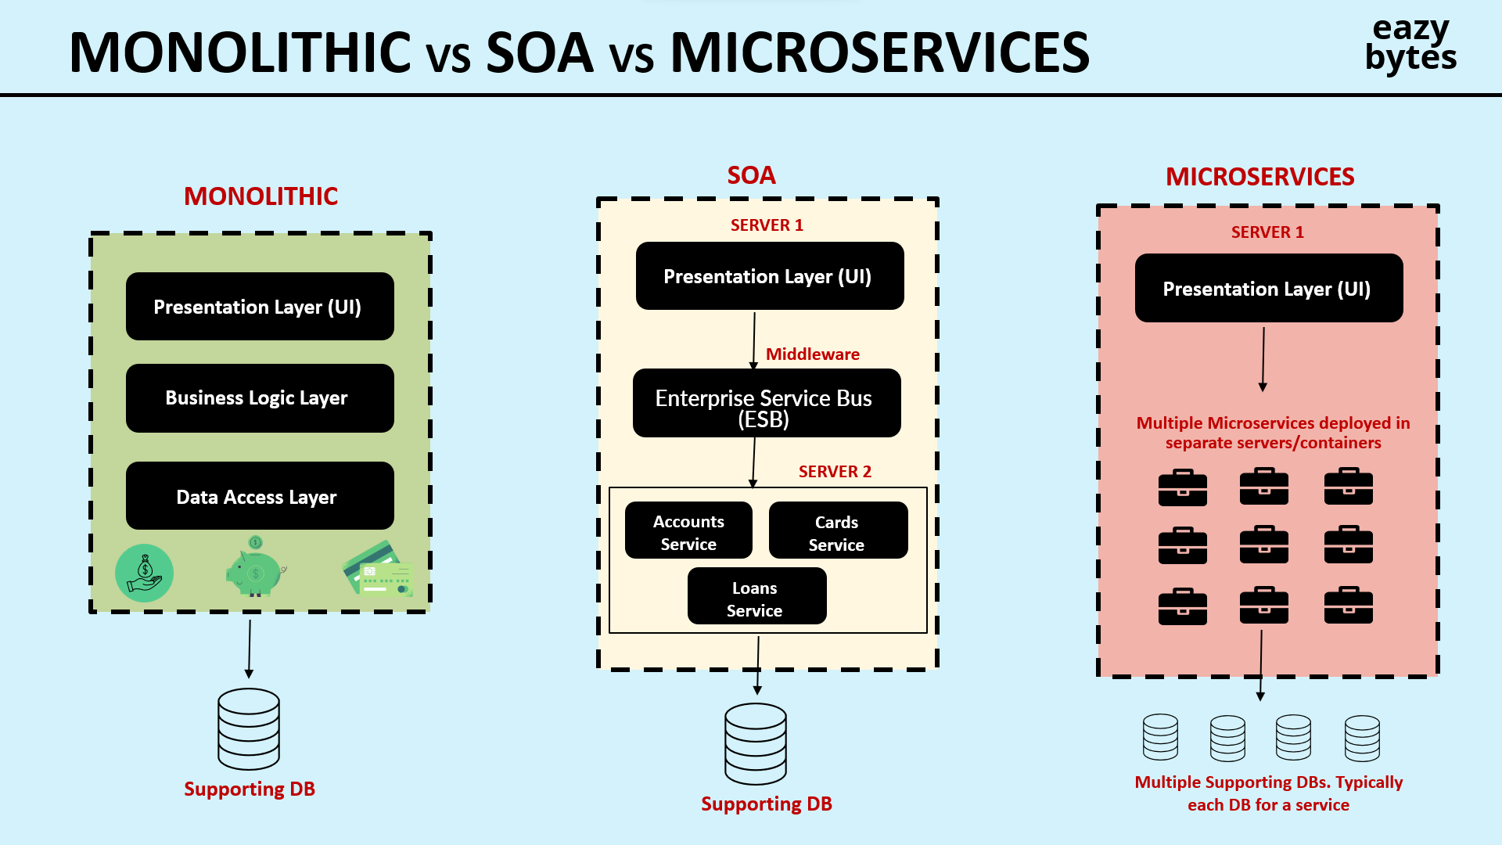

Slide 15
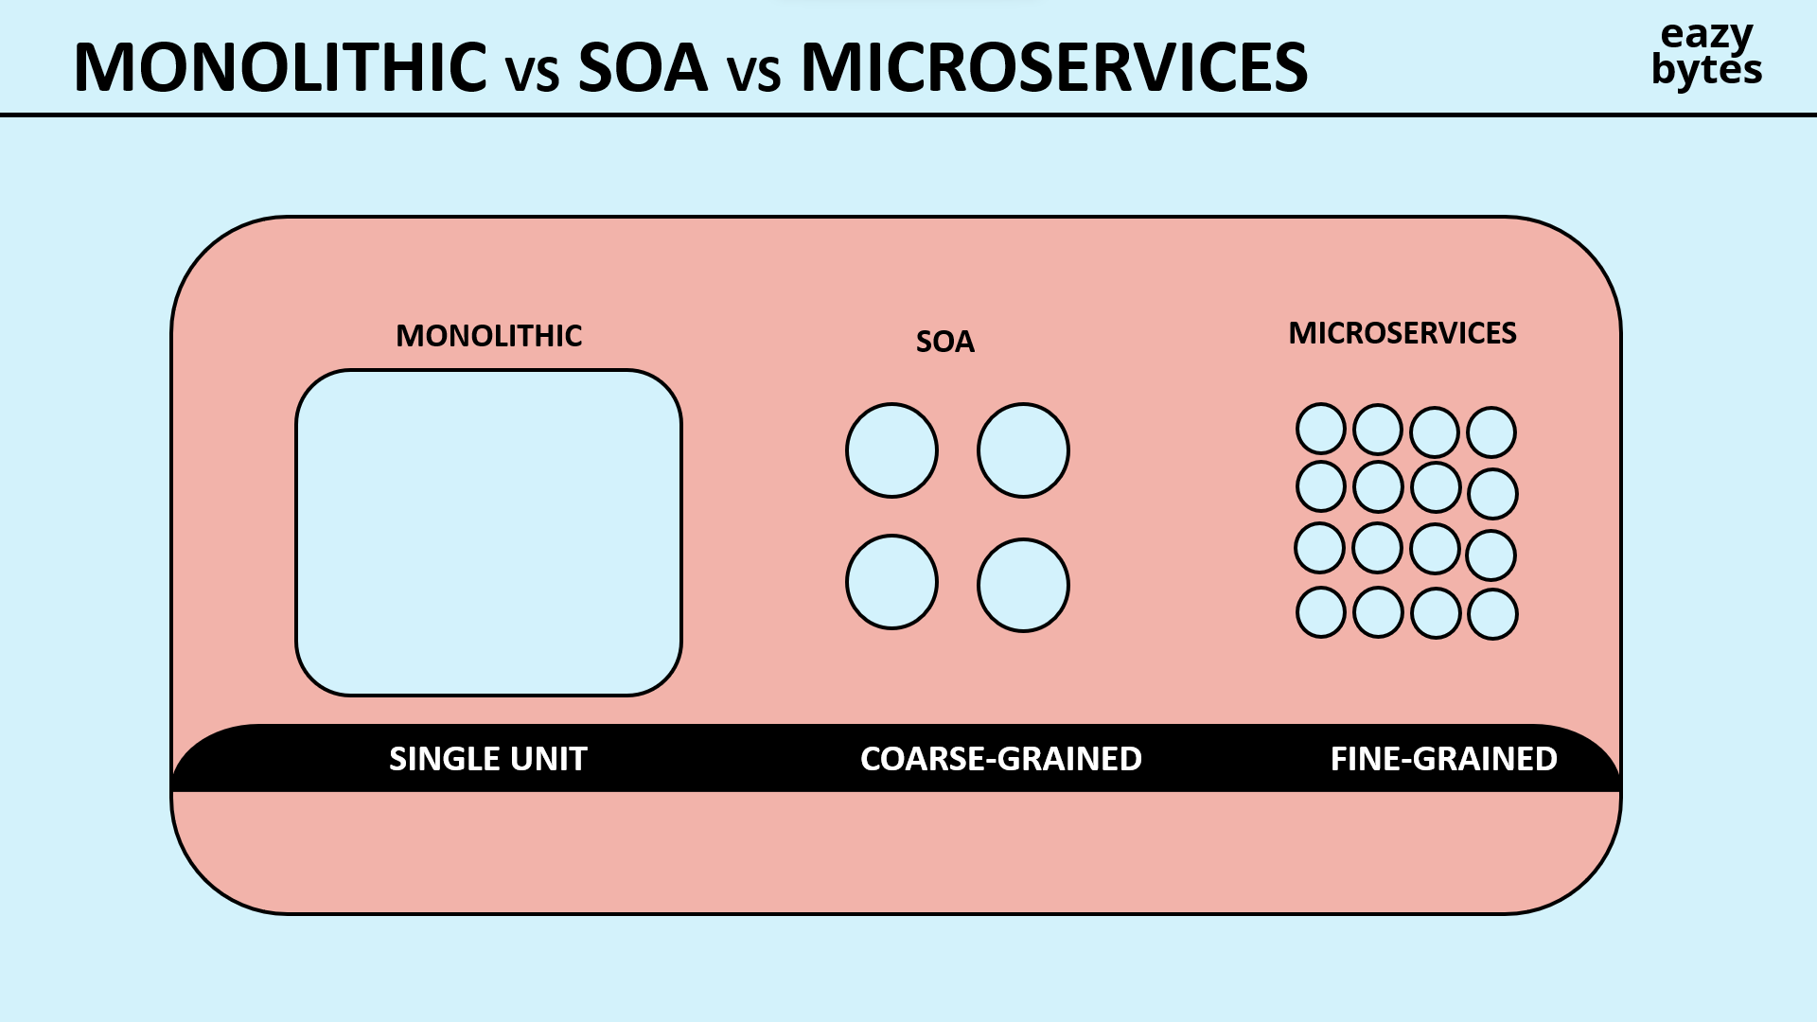

Slide 16
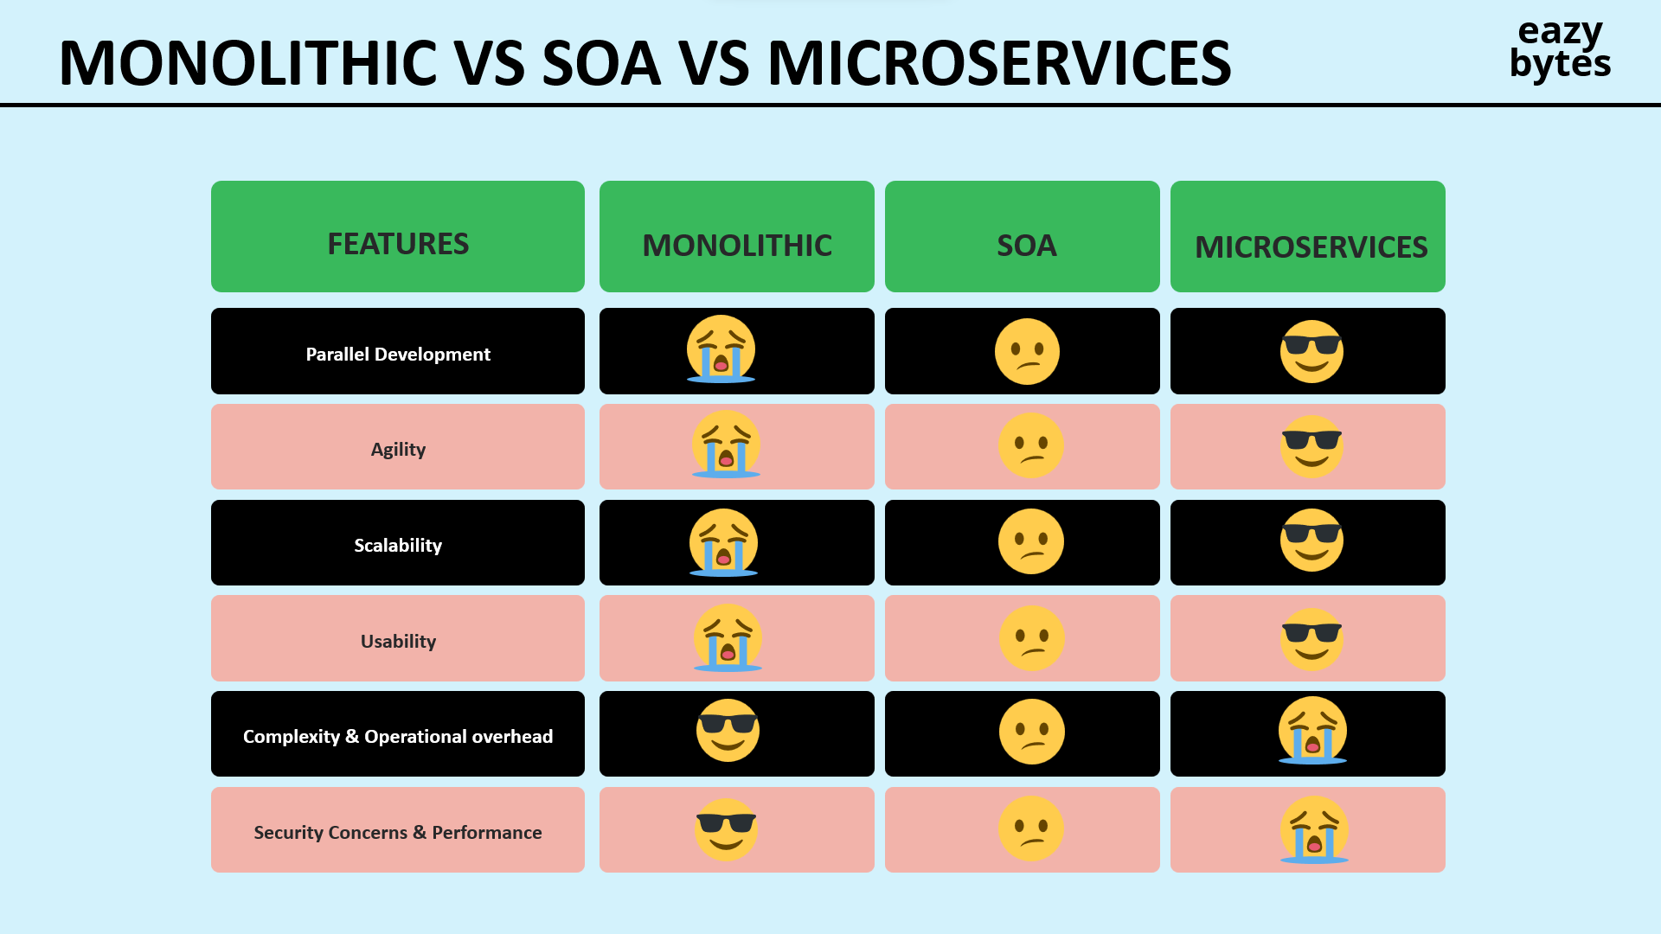

Slide 17
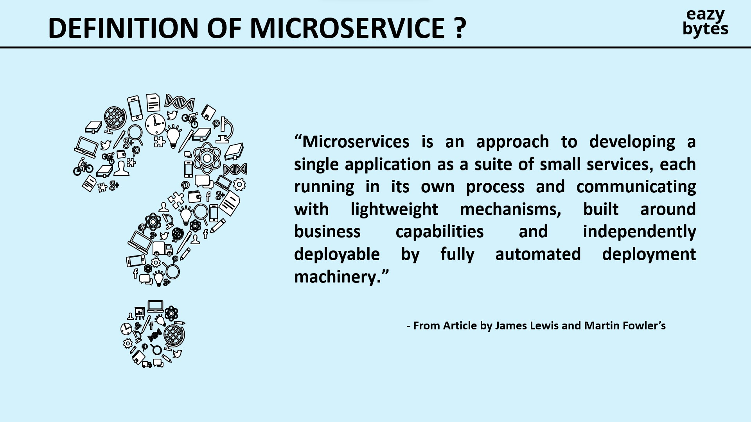

Slide 18
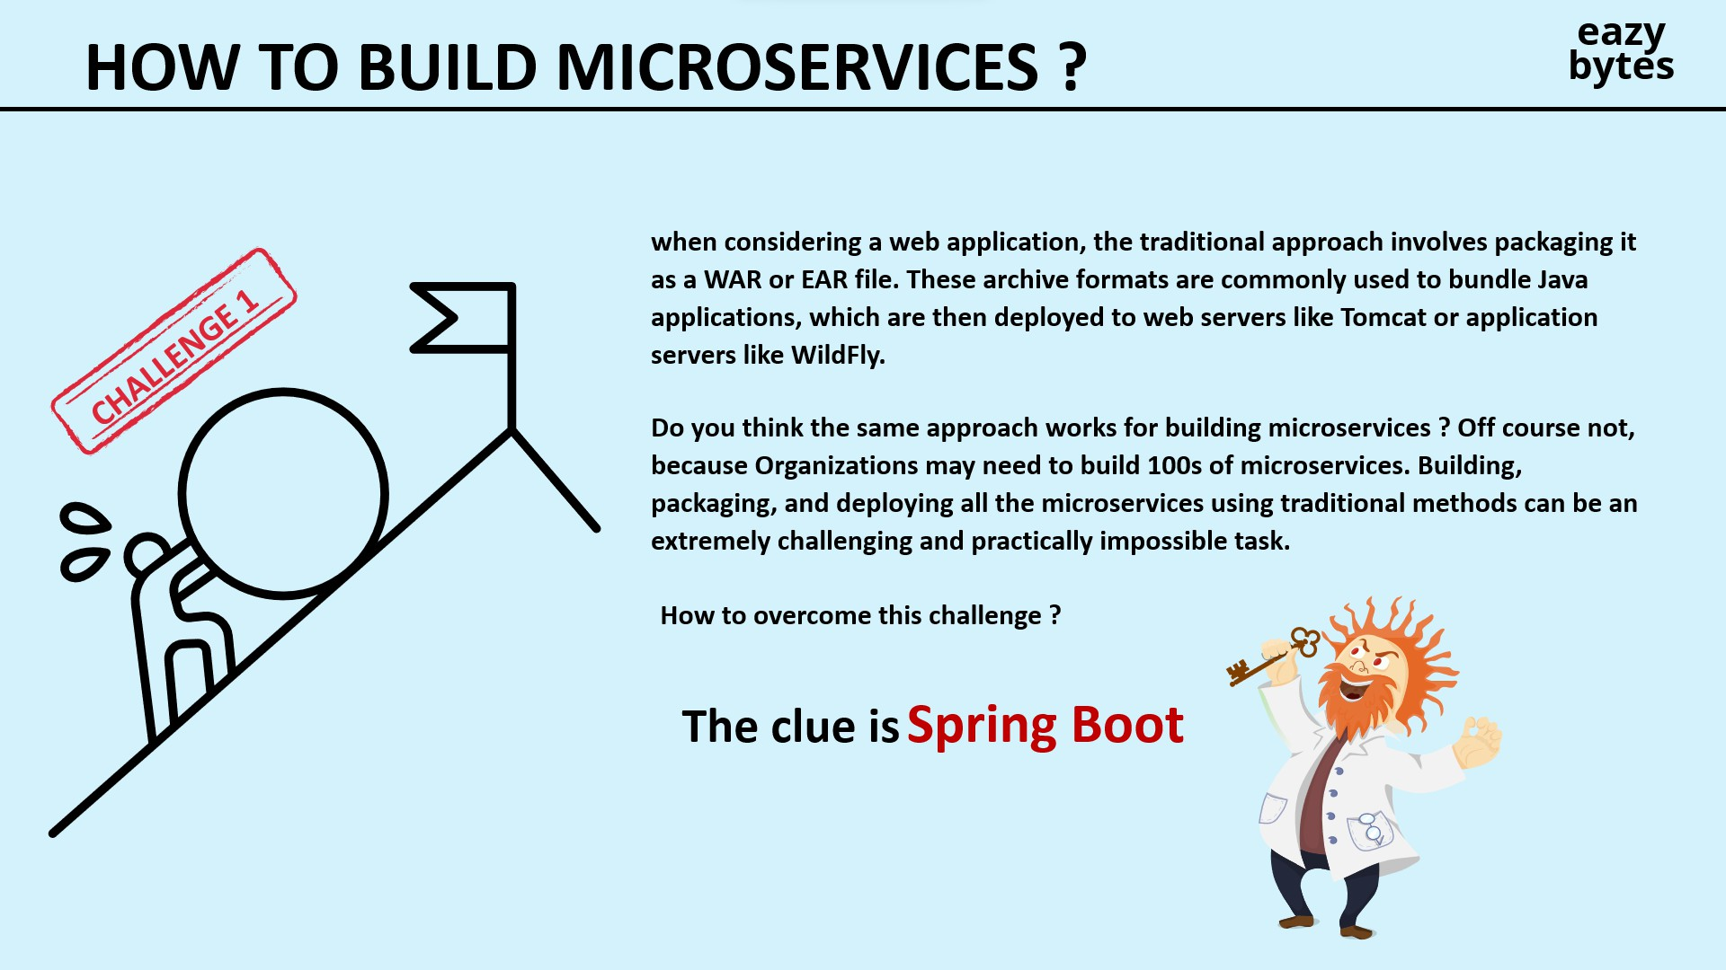

Slide 19
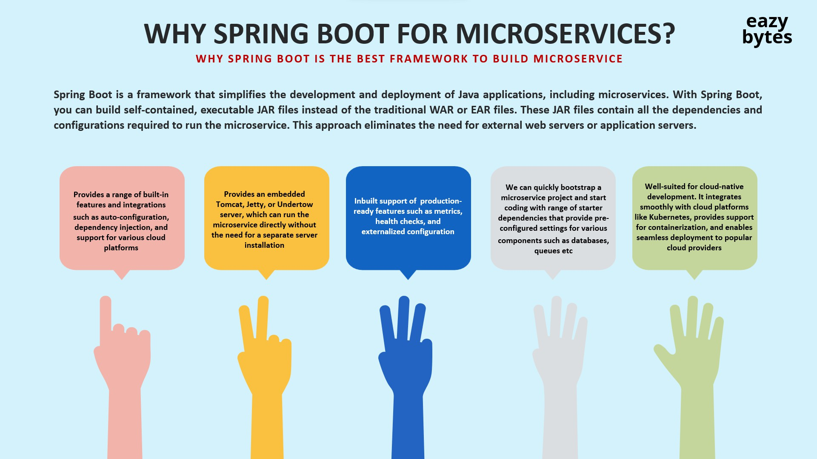

Slide 20
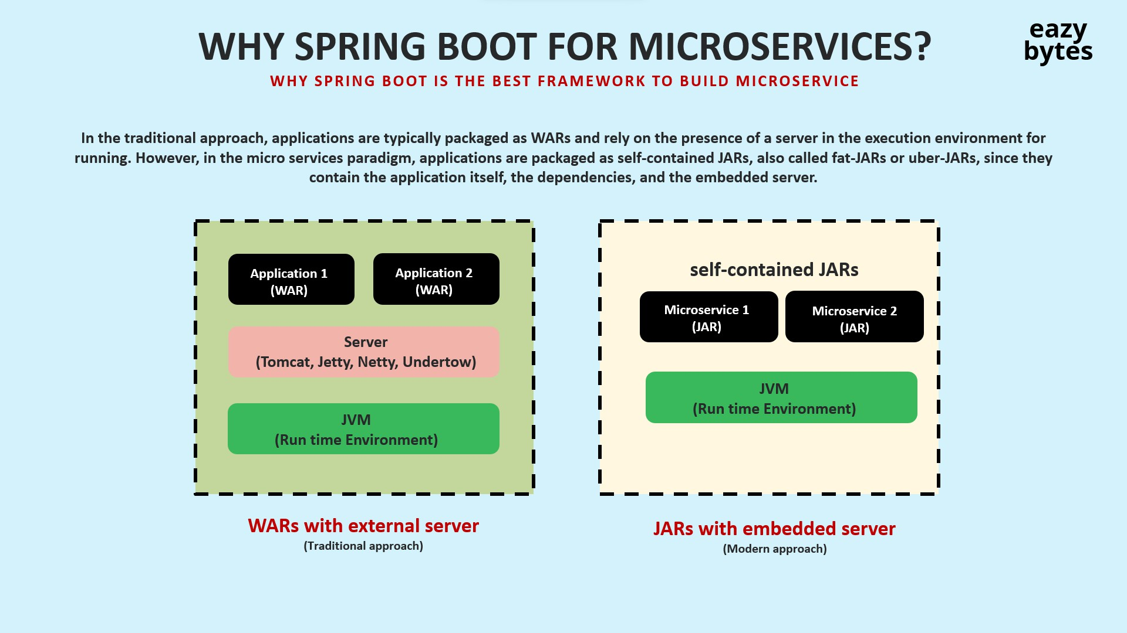

Slide 21
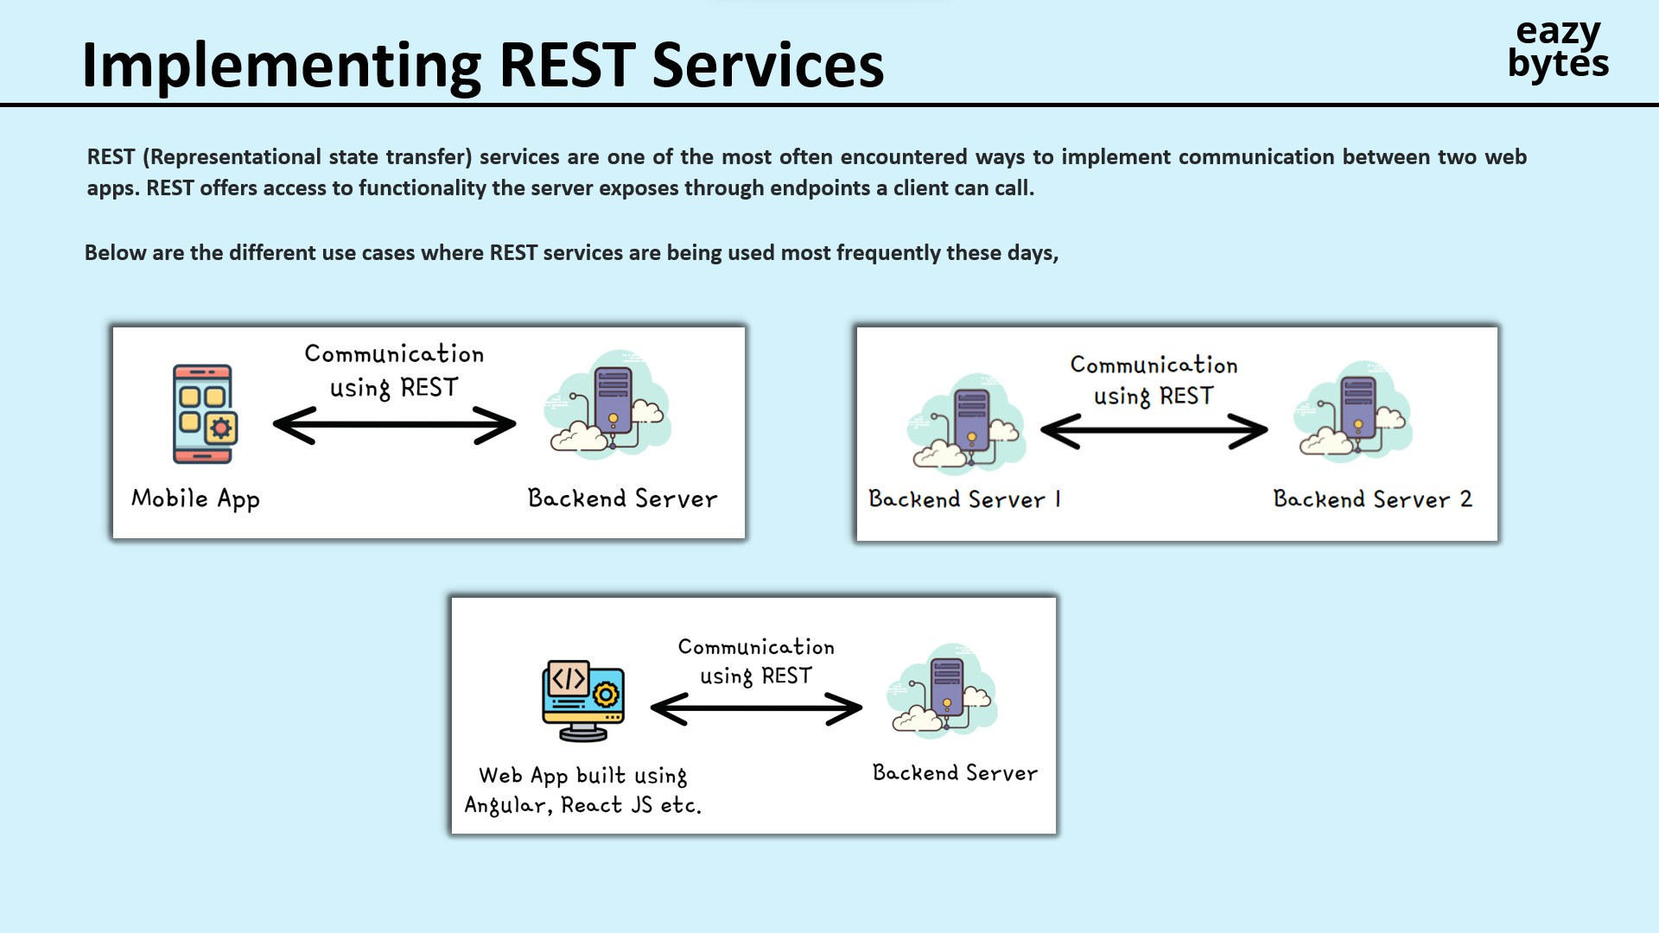

Slide 22
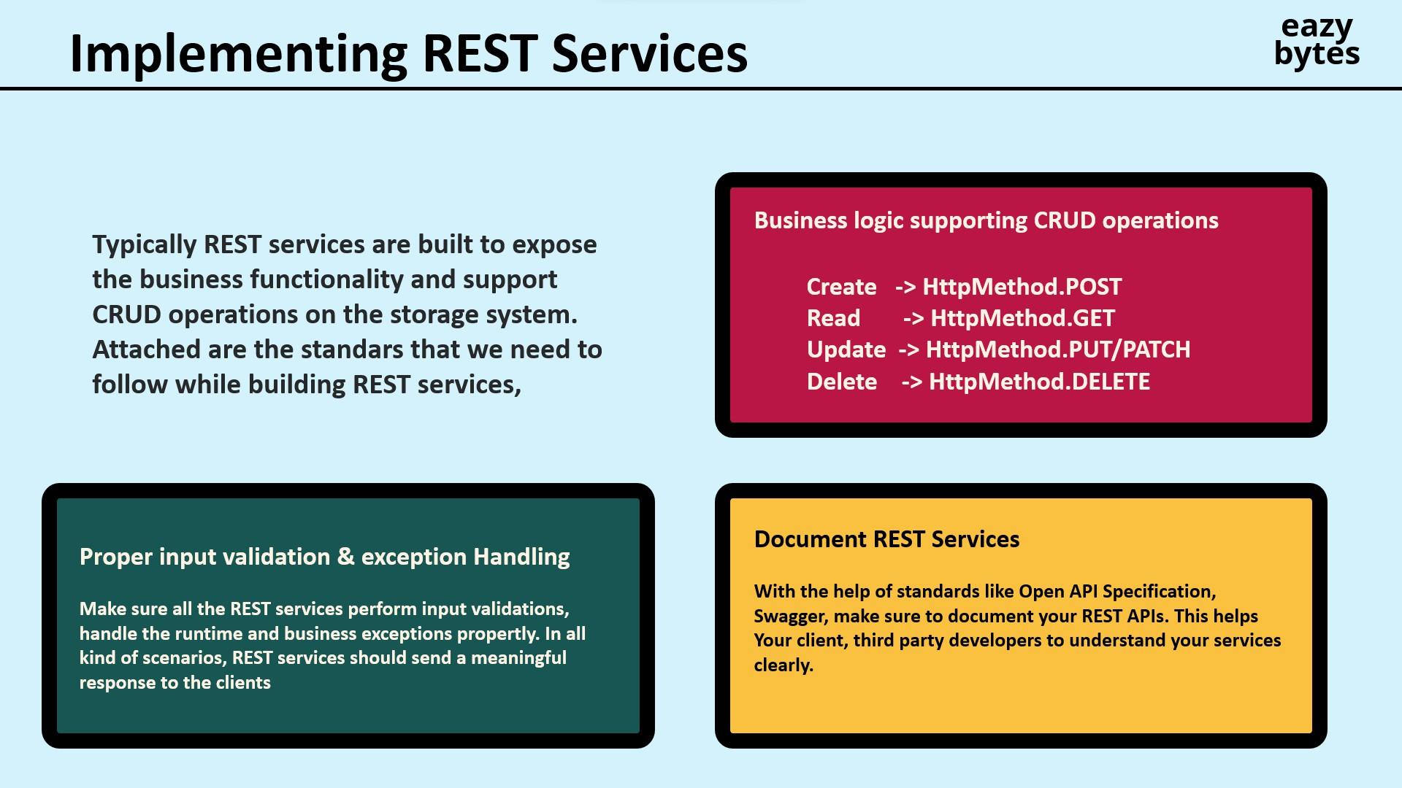

Slide 23
